Slide 1
Chaos, Experience, Context, Community
Presented by Kay Kok Chung Oi

Slide 2

Chaos
List out some of the themes that represent Chaos
War, famine and natural castastrophe.
Can the works of chaos absent from specific content?
Yes
King of the Mountain”, 2005, Oil/Acrylic on Canvas, 72”x 96”

Slide 3
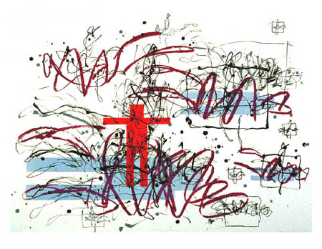
Chaos
Sleepwalker, 1991 Lithograph and relief print on Arches Cover white paper

